Slide 1
Driver Drowsiness Detection System

Slide 2
Introduction
A new approach towards automobile safety and security with autonomous region primarily based automatic automotive system is projected during this conception. We have a tendency to propose 3 distinct however closely connected ideas viz. a Drowsy Driver Detection system and a traffic detection system with external vehicle intrusion dodging primarily based conception. In recent time's automobile fatigue connected crashes have very enlarged. So as to attenuate these problems, we've incorporated driver alert system by watching each the driver's eyes still as sensing still because the driver state of affairs based primarily based native setting recognition based AI system is projected.

Slide 3
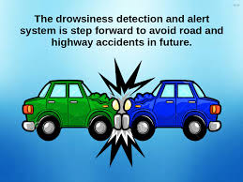

Slide 4
Driver drowsiness detection is a car safety technology which prevents accidents when the driver is getting drowsy. Various studies have suggested that around 20% of all road accidents are fatigue-related, up to 50% on certain roads. Driver fatigue is a significant factor in a large number of vehicle accidents. Recent statistics estimate that annually 1,200 deaths and 76,000 injuries can be attributed to fatigue related crashes. The development of technologies for detecting or preventing drowsiness at the wheel is a major challenge in the field of accident avoidance systems. Because of the hazard that drowsiness presents on the road, methods need to be developed for counteracting its affects. Driver inattention might be the result of a lack of alertness when driving due to driver drowsiness and distraction. Driver distraction occurs when an object or event draws a person’s attention away from the driving task. Unlike driver distraction, driver drowsiness involves no triggering event but, instead, is characterized by a progressive withdrawal of attention from the road and traffic demands. Both driver drowsiness and distraction, however, might have the same effects, i.e., decreased driving performance, longer reaction time, and an increased risk of crash involvement. shows the block diagram of overall system. Based on Acquisition of video from the camera that is in front of driver perform real-time processing of an incoming video stream in order to infer the driver’s level of fatigue if the drowsiness is Estimated then it will give the alert by sensing the eyes.

Slide 5
Problem Statement
Designing a prototype Drowsiness Detection System which will focus on continuously and accurately monitoring the state of the driver’s eyes in real time to check whether they are open or closed for more than a given period of time.

Slide 6
Python Libraries
OpenCV- pip install
opencv-python (face and eye detection).
TensorFlow- pip install tensorflow (keras uses TensorFlow as backend).
Keras- pip install keras (to build our classification model).
Pygame- pip install pygame (to play alarm sound).

Slide 7
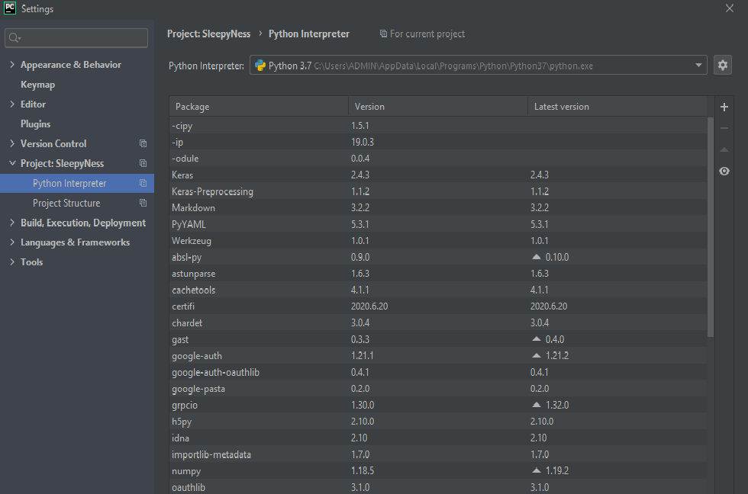

Slide 8
OPENCV What is OpenCV?
OpenCV is a Python open-source library, which is used for computer vision in Artificial intelligence, Machine Learning, face recognition, etc
In OpenCV, the CV is an abbreviation form of a computer vision, which is defined as a field of study that helps computers to understand the content of the digital images such as photographs and videos.

Slide 9
Face Detection Using OpenCV
This seems complex at first but it is very easy. Let me walk you through the entire process and you will feel the same.
Step 1: Considering our prerequisites, we will require an image, to begin with. Later we need to create a cascade classifier which will eventually give us the features of the face.
Step 2: This step involves making use of OpenCV which will read the image and the features file. So at this point, there are Numpy arrays at the primary data points.
All we need to do is to search for the row and column values of the face.
Numpy and array. This is the array with the face rectangle coordinates.
Step 3: This final step involves displaying the image with the rectangular face box.
Check out the following image, here I have summarized the 3 steps in the form of an image for easier readability:
Pretty straightforward, correct?

Slide 10
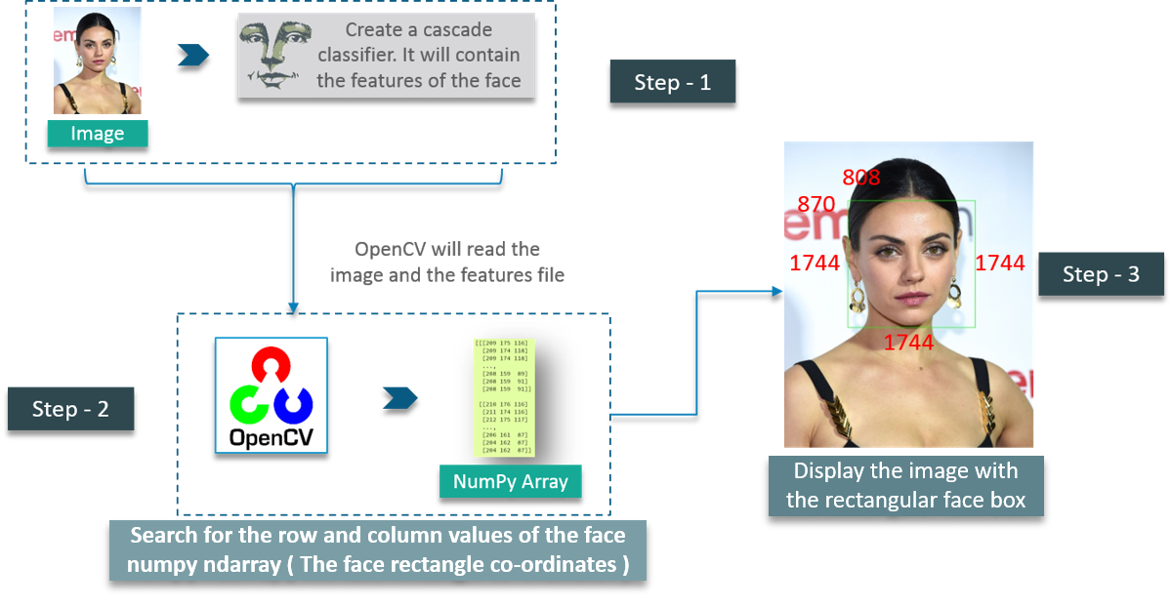

Slide 11
First, we create a Cascade Classifier object to extract the features of the face as explained earlier. The path to the XML file which contains the face features is the parameter here.
The next step would be to read an image with a face on it and convert it into a black and white image using COLOR_BGR2GREY. Followed by this, we search for the coordinates for the image. This is done using detect Multi Scale.
What coordinates, you ask? It’s the coordinates for the face rectangle. The scaleFactor is used to decrease the shape value by 5% until the face is found. So, on the whole – Smaller the value, greater is the accuracy.
Finally, the face is printed on the window.
Adding the rectangular face box:
This logic is very simple – As simple as making use of a for loop statement. Check out the following image

Slide 12
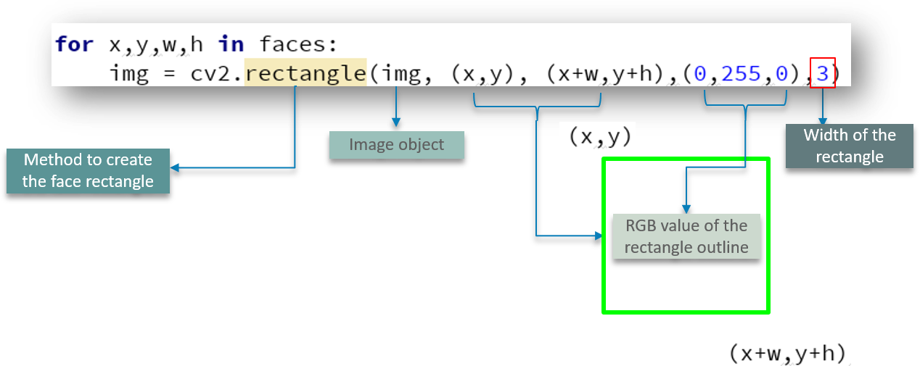

Slide 13
We define the method to create a rectangle using cv2.rectangle by passing parameters such as the image object, RGB values of the box outline and the width of the rectangle.

Slide 14
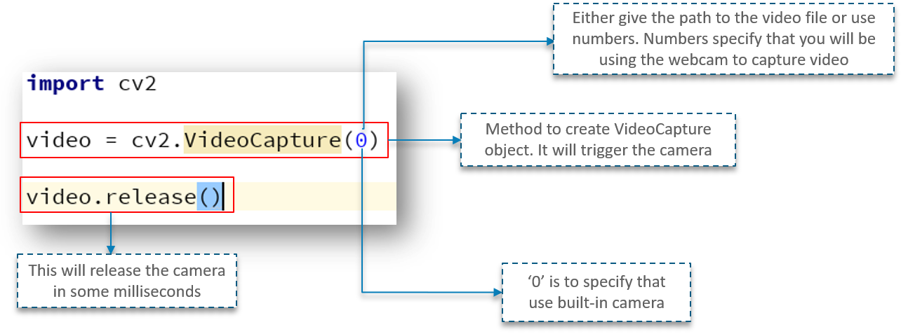
Capturing Video:

Slide 15
First, we import the OpenCV library as usual. Next, we have a method called Video Capture which is used to create the Video Capture object. This method is used to trigger the camera on the user’s machine. The parameter to this function denotes if the program should make use of the built-in camera or an add-on camera. ‘0’ denotes the built-in camera in this case.
And lastly, the release method is used to release the camera in a few milliseconds.
When you go ahead and type in and try to execute the above code, you will notice that the camera light switches on for a split second and turns off later. Why does this happen?
This happens because there is no time delay to keep the camera functional.

Slide 16
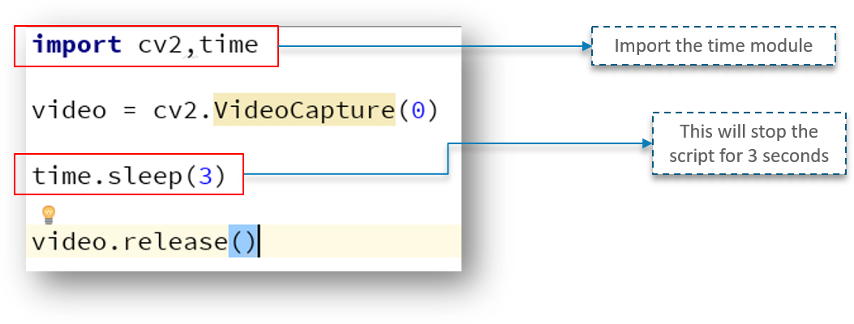

Slide 17
Looking at the above code, we have a new line called time.sleep(3) – This makes the script to stop for 3 seconds. Do note that the parameter passed is the time in seconds. So, when the code is executed, the webcam will be turned on for 3 seconds.

Slide 18
Algorithm :
1. Capture the image of the driver from the camera.
2. Send the captured image to haar cascade file for face detection.
3. If the face is detected then crop the image consisting of the face only. If the driver is distracted then a face might not be detected, so play the buzzer.
4. Send the face image to haar cascade file for eye detection.
5. If the eyes are detected then crop only the eyes and extract the left and right eye from that image. If both eyes are not found, then the driver is looking sideways, so sound the buzzer.
6. The cropped eye images are sent to the hough transformations for detecting pupils, which will determine whether they are open or closed.
7. If they are found to be closed for five continuous frames, then the driver should be alerted by playing the buzzer.
8. Cut the 3/4th portion of the face image and send it to haar cascade file for mouth detection.
9. If the mouth is not detected, it indicates a yawn and so, the driver needs to be alerted by playing the buzzer.
10. Repeat the above procedure continuously in a rapid loop as long as the car is moving.

Slide 19
Advantages
Detects drowsiness.
Decreasing road accidents.
System implemented without using database storage.
No wires, cameras ,monitor or other devices are to be attached or aimed at the driver.
Due to the non obstructive nature of these methods they are more practically applicable.

Slide 20
Disadvantages
It will not work with people having dark skin.
There should not be any reflective object behind the driver.
This system can be used in factories to alert the workers.
If found drowsy, the alarm system gets activated and the driver is alerted.
If there is any obstacles it is alerted to the driver.

Slide 21
CONCLUSION
The driver abnormality monitoring system developed is capable of detecting drowsiness, drunken and reckless behaviours of driver in a short time. The Drowsiness Detection System developed based on eye closure of the driver can differentiate normal eye blink and drowsiness and detect the drowsiness while driving. The proposed system can prevent the accidents due to the sleepiness while driving. The system works well even in case of drivers wearing spectacles and even under low light conditions if the camera delivers better output. Information about the head and eyes position is obtained through various self-developed image processing algorithms. During the monitoring, the system is able to decide if the eyes are opened or closed. When the eyes have been closed for too long, a warning signal is issued. processing judges the driver’s alertness level on the basis of continuous eye closures.

